Slide 1
www.rswr.org
101 Quaker Hill Drive, Richmond, Indiana 47374
Notes:
Right Sharing of World Resources is an international Quaker organization founded by Friends World Committee for Consultation in 1967. Friends from around the world gathered to share concerns about environment, population, and resources and seek ways to put their faith into action.

Slide 2
Mission
God calls us to the right sharing of world resources,
from the burdens of materialism and poverty
into the abundance of God’s love,
to work for equity through partnership
with our sisters and brothers
throughout the world.
Notes:
[Read mission aloud.] Our founding mission speaks to us today as it did over fifty years ago.

Slide 3
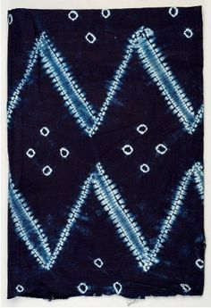
Goals
To provide opportunities for those blessed with material resources to explore the burdens of materialism, the power of enough, and global responsibility; and to promote balanced sustainable lifestyles and sharing rightly from abundance.
Notes:
Right Sharing of World Resources has two essential goals. One is: [Read goal aloud]
These opportunities invite us to look inward and reflect on how each action we choose ripples out and touches others.
The traditional fabric pictured here is hand loomed and tie-dyed in Sierra Leone.

Slide 4
The Power of Enough
How can I balance my use of time, energy and things to free me to do God’s work and contribute to right order in our world?
Notes:
One educational opportunity RSWR offers is workshops on The Power of Enough facilitated by RSWR General Secretary, Jackie Stillwell. In addressing the question “How can I balance my use of time, energy and ‘things’ to free me to do God’s work and contribute to right order in our world? she begins with the query “What is essential?”. Participants listen to each others stories, reflect inwardly, notice how gratitude and abundance shape our choices, and consider personal next steps.
Contact RSWR for more information to attend a workshop, or to invite Jackie to facilitate a workshop for your local, quarterly or yearly meeting gathering.

Slide 5
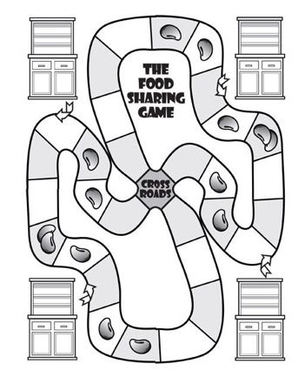
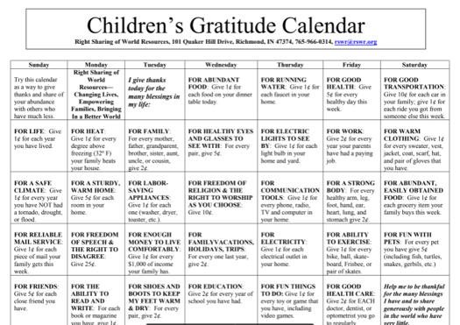
Games and Activities
Notes:
Another way that we look at abundance and ‘the power of enough’ is via games and activities for First Day School. This food sharing game is a cooperative game where everyone wins when everyone has enough food. The children’s calendar encourages daily gratitude practices and is a wonderful activity in November leading up to Thanksgiving. There is also a gratitude calendar for adults! These and other activities are available on our website.

Slide 6
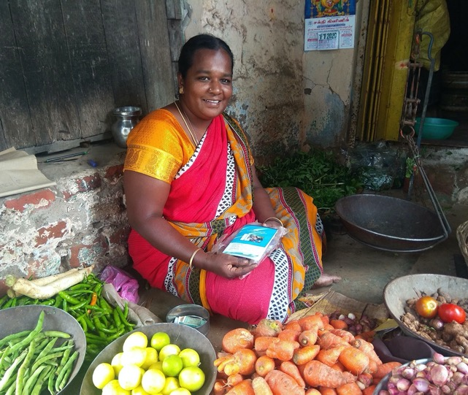
Goals
To provide resources for marginalized women in developing countries to improve the quality of life of the women, their families, and their communities, and to empower these women in a sustainable and self-determined way.
Notes:
This goal is perhaps the goal for which we are best known. [Read goal aloud] It will be the primary focus of this slide presentation.
This image is of a woman in Tamil Nadu, India managing her own vegetable selling business.

Slide 7
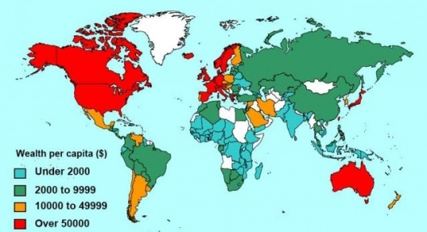
India
Kenya
Sierra Leone
Notes:
Right Sharing of World Resources works in 3 of the poorest countries in the world: India, Kenya, and Sierra Leone. This map shows the wealth per capita. The light blue countries have the least per capita income, and the red countries have the highest. As you can see the need is great is many countries.
Why does RSWR work in these 3 countries? We began in India over 30 years ago as the result of a connection with Gandhian communities; this led to our first grants for microloans. The largest number of Quakers in the world are in Kenya so it was a logical connection to help the underserved there. In Sierra Leone there was a Peace Corps connection through a board member.

Slide 8
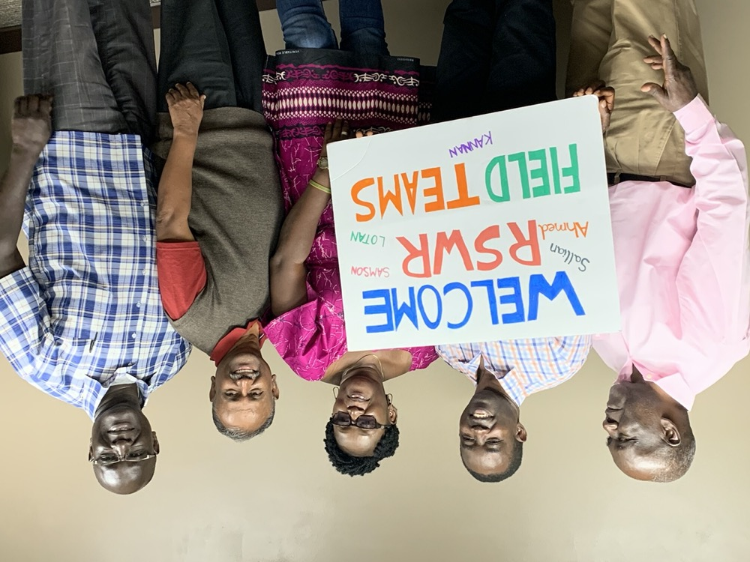
Notes:
These are our Field Representatives who were able to come to the USA in October 2019 for our first ever Field Representative consultation. Field Representatives in each of these 3 countries are essential in designing and implementing programming to meet local needs. You can read more about each of them, and the two missing Field Reps, on our web pages.

Slide 9
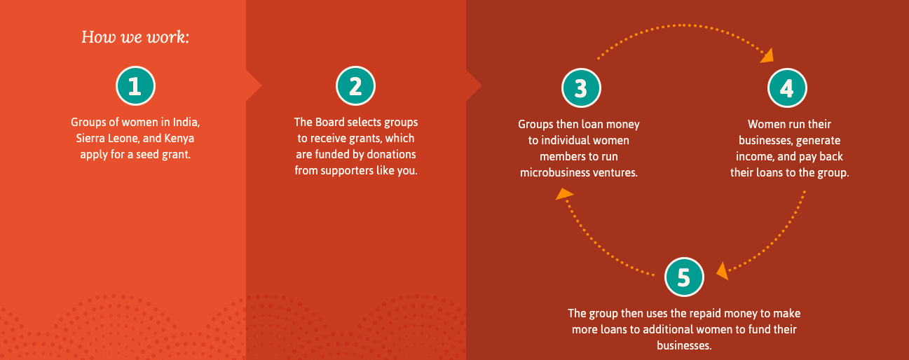
Notes:
How do we work in the overseas programs? [Read aloud 1-5]
Note that unlike many microlending organizations, the funds are not repaid to Right Sharing of World Resources. Each grant is given to women in community, and the funds stay and grow in their community. The grant amount is about $5,000 for a group of 20-30 women. The groups use the money to give loans to members to start small businesses. Each woman receives a loan of somewhere between $25 and $200.

Slide 10
41 Groups received an RSWR seed grant
-
1,092 women received a loan from initial grant funds
-
3,276+ lives changed by RSWR
2019
Notes:
What is the impact of grants given in each calendar year? [Read slide aloud]
Note that these numbers are for grants given in 2019. The grants given in prior years are not reflected here. Grants from prior years continue to revolve and ripple forward to reach millions of women over time.

Slide 11
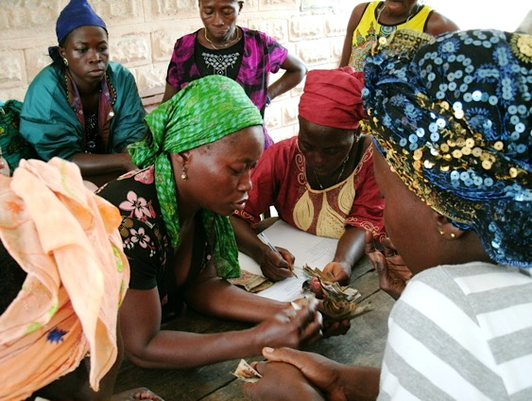
Loans are paid back to the group,
then loaned out again to other women.
The money recirculates.
Notes:
The women pay their loans back to the group a little each month. So if a woman borrowed $100 she might pay back $10 per month until it was all paid plus a small amount of interest. The group owns the money. When the money comes back, the group saves the interest for future trainings or emergency funds, and loans the principle out to other women. The original grant is revolved many times in the community.
In this picture, women in Sierra Leone are making their monthly loan repayments and the treasurer is recording it in the ledger.

Slide 12
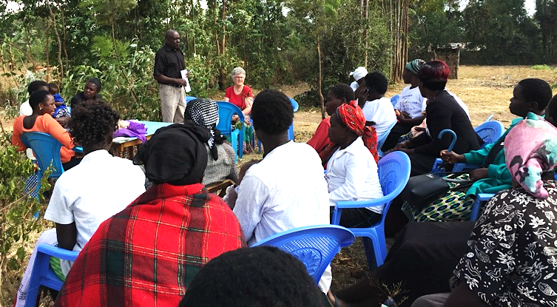
Training is an important element of success
Notes:
Over the many years that RSWR has been doing this work, we have learned that training is an important element of success. All the women in the RSWR groups receive basic training in business management, account keeping, marketing, and networking.
This is Lotan doing a business training in Kenya during a visit from Sarah Northrop, Program Director.

Slide 13
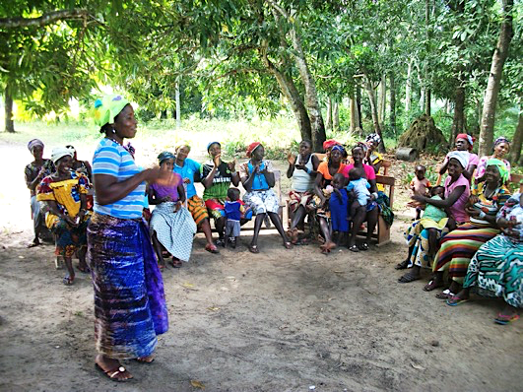
Group & social dynamics training
Notes:
Another area of training that RSWR offers to our partners is training in social dynamics. Social dynamics is just as important as financial training! Here, a group in Sierra Leone role-plays how they would deal with common problems that they might encounter, such as how they will respond if their husbands, children, or other relatives ask for some of the money they have received to start their business or what to do if a family member gets sick and needs attention and funds.

Slide 14
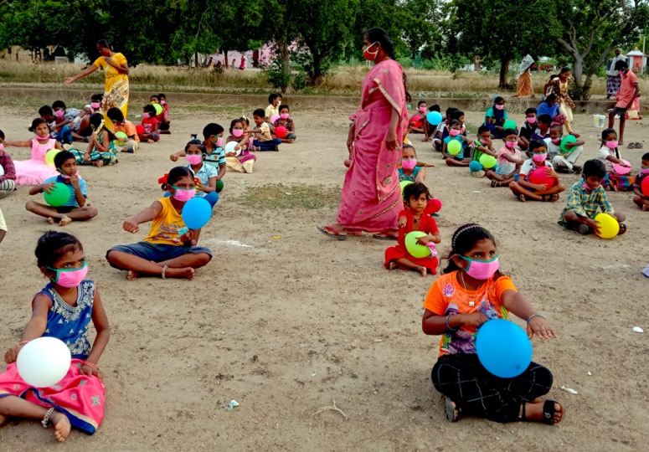
Health Education
Notes:
Photo -Indian children with masks and balloons. Title - Health Education
Field Representatives sometimes provide training on health issues. This group in India is instructing their children on mask wearing, hand washing and social distancing during the coronavirus pandemic. As a result of relationships RSWR Field Representatives have built with rural villages in Sierra Leone, they are trusted during a health crisis such as Ebola or Covid 19 to explain the necessary health precautions.

Slide 15
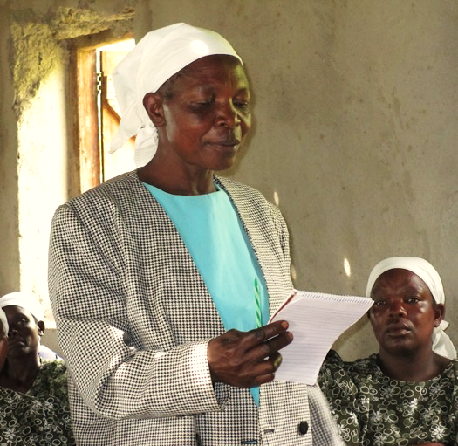
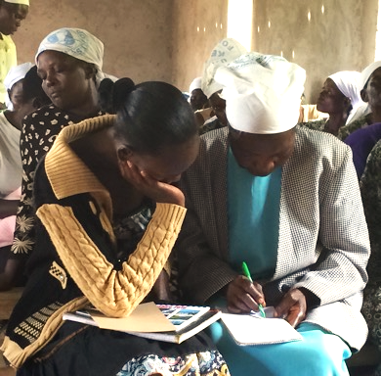
Learning and Leadership
Notes:
Title – Learning & Leadership (crop photos)
RSWR grants encourage leadership among women. Here the chairlady and secretary in a Kenyan women’s group confer over a speech the chairlady then gives to visitors. The chairlady is translating from her tribal language into English, which she does not speak. Although English is spoken in India, Kenya and Sierra Leone, women learn first their tribal language, and then the regional or country language. English would be their third language. The secretary has learned English at school. Imagine how you might feel to translate a report and give it publicly in a language you have never spoken.

Slide 16
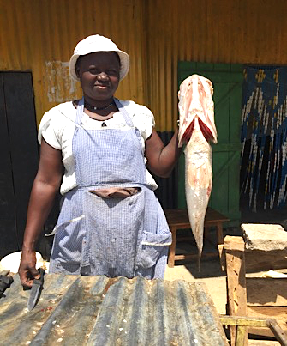
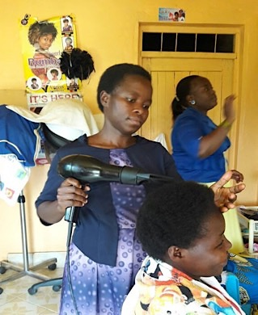
Locally Based Businesses respond to the needs of the Community
Notes:
What kinds of businesses do women do?
An unique aspect of the RSWR program is that RSWR requires that the products of the women’s businesses are made for local consumption, not for export. Their businesses respond to the immediate needs of their community.
Both these women are Kenyans. The woman on the left cleans and sells fresh, a staple in her community. The woman on the right is a hairdresser who started her own business, and now teaches other women the art of hair dressing.

Slide 17
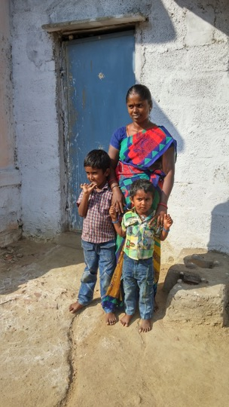
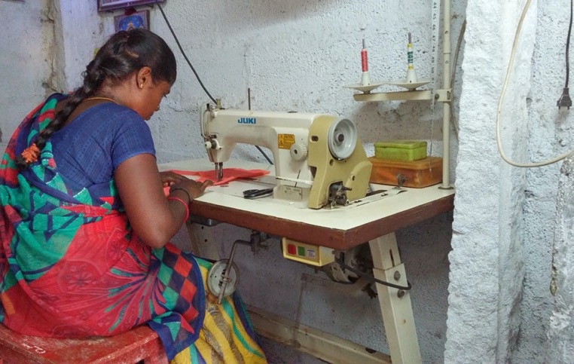
Notes:
Tailoring is another profitable business that benefits the community in both Kenya and India. Many women learn to sew in schools and training centers, but must work for a clothing factory for low wages because they don't own a sewing machine. With a grant from RSWR, they can buy a sewing machine and start their own business. This is Manaka from India. She now makes around $3 to $4 per day, nearly 3 times what she used to make. She is so happy to be able to work at home where she can care for her children while she sews.

Slide 18
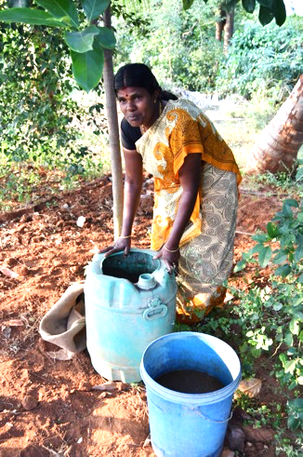
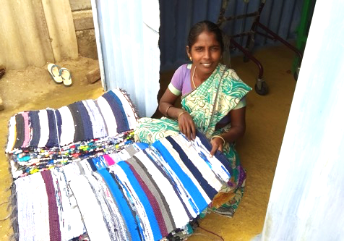
Environmentally Friendly Projects
Notes:
RSWR women partners create environmentally friendly businesses. Agricultural projects do not use chemical fertilizers or pest control. In India, RSWR often supports groups working to reclaim their family farmlands, which have been made infertile by the overuse of chemicals.
The woman on the left is named Jothi, she makes mats from reclaimed materials in her home. This also allows her to be with her child during the day.
The woman on the right is preparing to use organic fertilizer that she made with rotten eggs, dead fish and locally available materials.

Slide 19
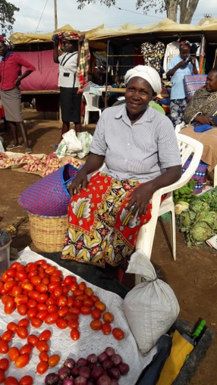
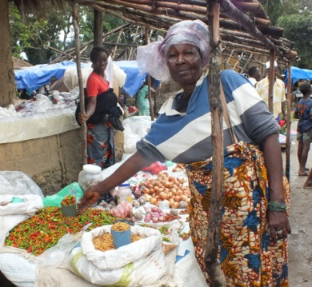
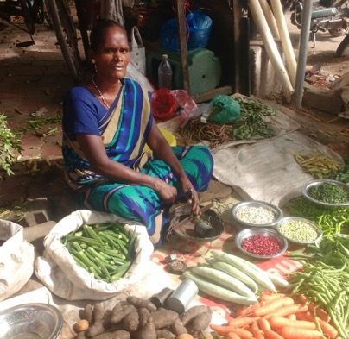
Kenya
Sierra Leone
India
Notes:
In all three countries people are selling in the markets. They sell food and other necessities which provide for their communities and bring profit to their families

Slide 20
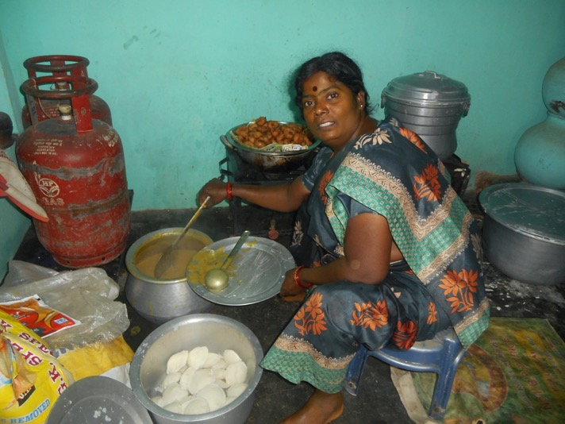
Value added products
Notes:
Prepared foods are value added products, meaning that a small amount of production increases the sale price of a staple. For example - making flour into donuts or smoking fish increases the market value and therefore the profit of the product. This woman is providing “take-out” from her home. She has prepared a simple Indian meal of dal and idly (rice cakes), with a donut for desert ☺

Slide 21
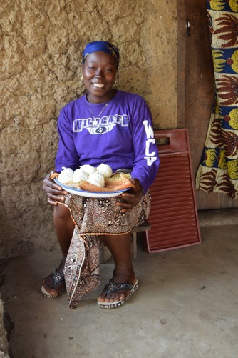
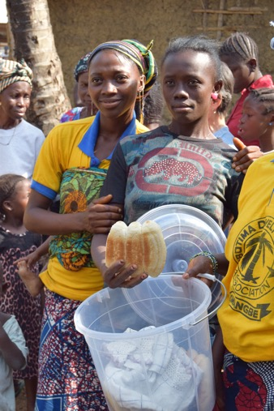
Support Community
Notes:
These women live in a small, remote village in Sierra Leone. They make soap and bread. Twice a week, they get up at 3 in the morning and walk the 4 hours to markets in larger towns. They sell their soap and bread there, and then use the money they make to buy commodities that are needed in their village. Then they walk back and sell the things that they bought in the large market to their neighbors in the village. This increases their profits and provides their community with supplies that are otherwise difficult to obtain.

Slide 22
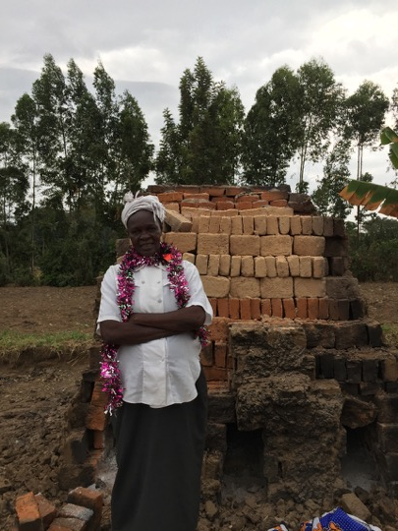
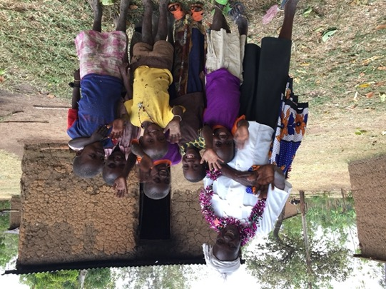
Notes:
Brick Making is a common business in the western part of Kenya because of the claylike soil. When you drive down the road, you can see people firing bricks by the side. This woman is the grandmother of these children and she has a brick making business that helps support them.

Slide 23
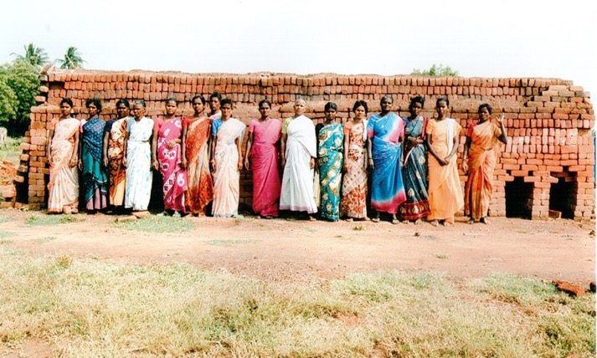
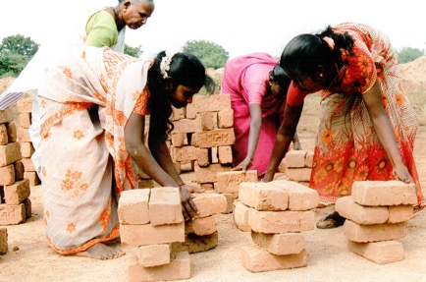
Bonded Labor
Notes:
In India, there are many commercial brick kilns that engage in an illegal practice called “bonded labor”. Poor people are enticed to come work for them by giving them a large advance of money. This advance comes with a high interest rate and the ”bonded” employees can’t leave until the advance and interest are paid off. Since the daily pay is very low and the interest is high, workers are not able to paid off the debt. This creates a situation where bonded laborers have effectively entered into slavery. With the help of an RSWR grant, these workers are able to pay back their advance, set up their own brick factory, and share the profits.

Slide 24
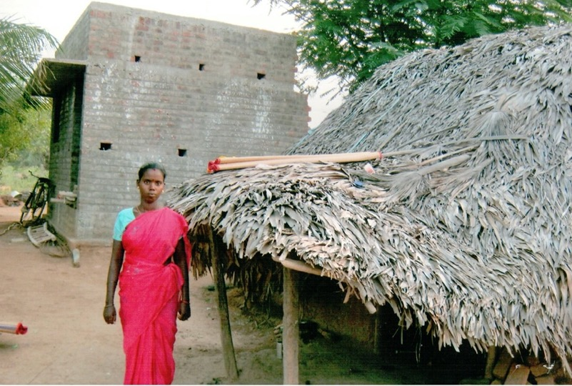
From Bonded Laborer to Homeowner
Notes:
The woman in this picture became a bonded laborer at a young age. When her self help group received a Right Sharing grant, she paid off her ‘loan’ and started her own brick making business . After several years she moved from the thatched roof hut she grew up in, to the two store brick house she was able to build with her new earnings. She even has a bicycle now!

Slide 25
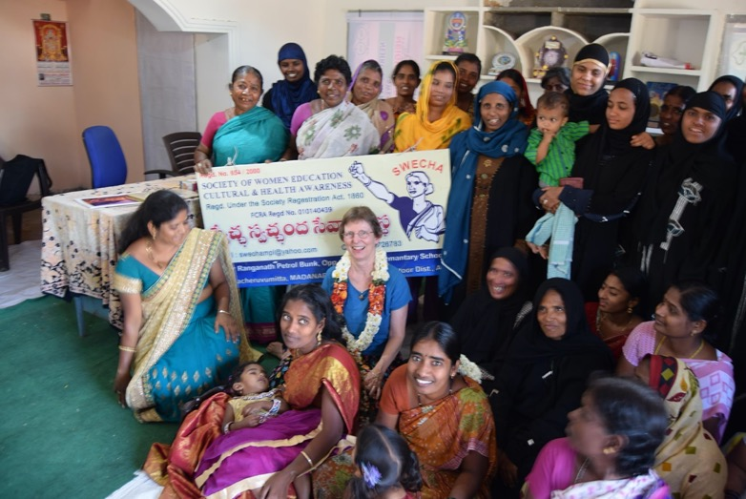
Relationships across boundaries
Notes:
A RSWR grant is more than starting a business. It is a partnership that affirms women and opens the door to learning and leadership, empowering them to transform family and community life.
Here is a self help group meeting in India. These groups of 20-30 women support each other with problems or needs that arise. The peer support helps the women to have a better chance of success in personal and family life as well as community and business. Notice that this group is a combination of Muslim, Hindi and Christian women. It is a cultural taboo for women from different religions to talk to each other in India. However with an RSWR grant, women gain economic power and permission to join together and support each other. Eventually there is a shift as the connection between the women integrates the community and gradually ripples out to the men.
RSWR encourages grant applications from groups with relationships across boundaries. In Kenya this encompasses multiple tribal groups.

Slide 26
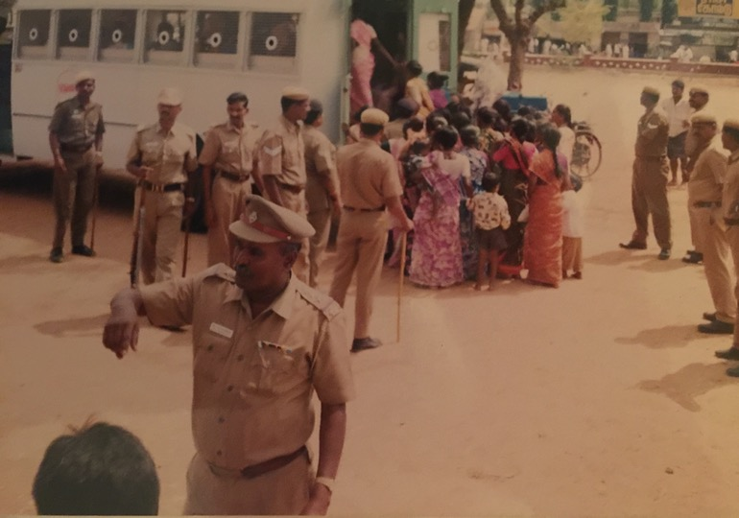
Women advocating for themselves
Notes:
Another outcome of women’s groups is that women begin to advocate for each other and stand up for themselves, often in ways that are not easily visible. Pictured here is a public example of a women’s group being arrested for non-violently protesting because a landowner cut off their access to a water supply. The powerful man called the police and thought he was done with the bothersome women. But because there were so many women involved, the court took them seriously, released them from jail, and made the landowner restore the water.

Slide 27
Notes:
In another instance, in India in 2015, this handicapped RSWR beneficiary was raped by a distant relative. Crimes such as this against women often go unpunished in India, and even though the woman pressed charges, the police refused to arrest the man. Then the woman’s self help group came to her aid and began demonstrating outside the police station. The local press took notice and the police were forced to arrest the rapist.

Slide 28
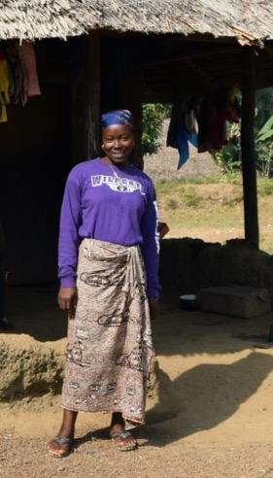
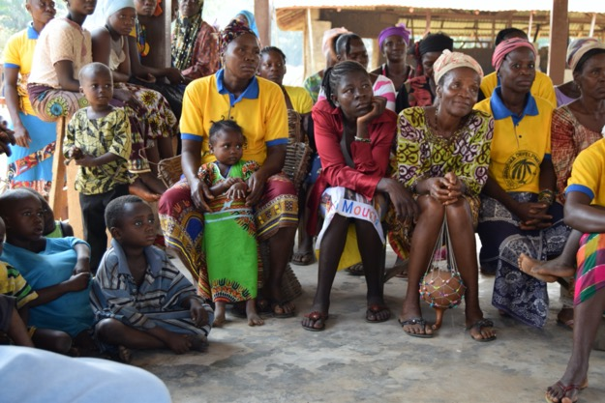
Notes:
In Sierra Leone, the support of the group has been invaluable to women who are survivors of the Ebola disease. Ebola struck Mamie Kamara’s home in July 2014. Her husband and all of her children died. She also became ill with the disease and was taken to the Kenema treatment center. When she returned to her village, she had no surviving family members. Her neighbors and friends distanced themselves from her and wouldn’t interact with her. At this point, she met the director of Tewoh Community Development Organization, a Right Sharing partner, who encouraged her and welcomed her into the group. As we saw earlier, she has started a soap making business with her micro-loan, and she is now reintegrated into her community.

Slide 29
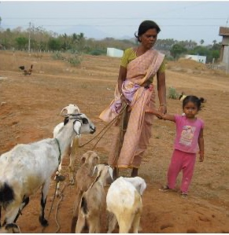
When you support a woman to begin a business, you support her whole family.
Notes:
As Right Sharing has evolved, we have come to the decision to support only women’s groups. Part of the reason for this is that statistics show that women are more likely to invest their income in their families, Children eat better and have access to healthcare. This little girl will have milk on a daily basis since her mother is now raising goats.
Children eat better and have access to healthcare. This little girl will have milk on a daily basis since her mother is now raising goats.

Slide 30
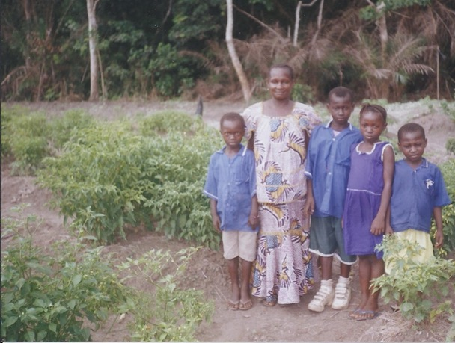
School Uniforms
Notes:
In many countries children are required to wear school uniforms. Uniforms are expensive and must be purchased. This means that If you cannot afford uniforms, you cannot attend school. This woman in Sierra Leone is proud to have earned enough with her RSWR vegetable business to buy uniforms and send her children to school.

Slide 31
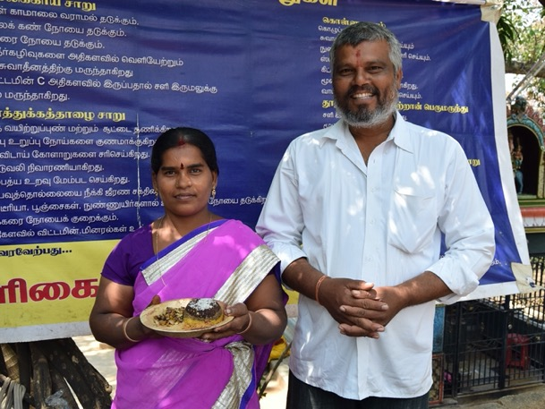
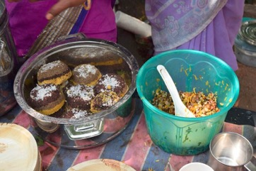
Men and RSWR Projects
Notes:
While RSWR has chosen to give grants to Women’s Groups because statistics show that women are more likely to invest their income in their families, that does not mean that men are not involved with the RSWR projects. Often husbands help and support their wives in their businesses. This man in India left his seasonal agricultural work to support his wife in her organic food business. They work together (she’s in charge) and are reintroducing nutritious traditional Indian food to a current culture of overly processed fast foods.

Slide 32
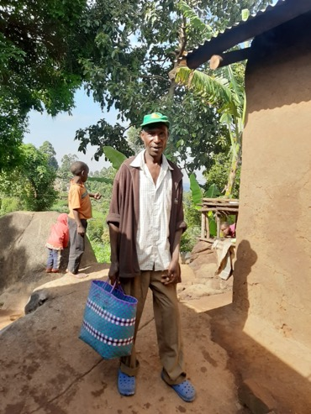
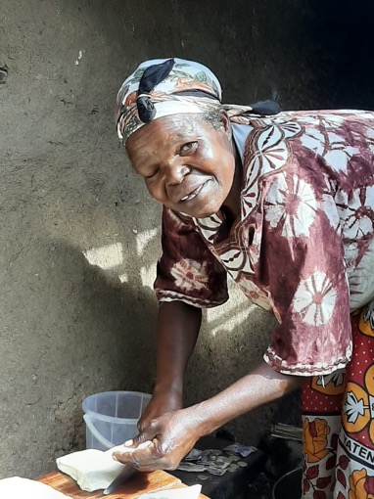
Notes:
However, there are also other reasons for supporting women. RSWR grants give women more than just financial help. In all three countries where we work, women are seen as second-class citizens. Upon receiving a loan that allows her to start a business and earn money, a woman gains political and social power that accompanies ownership of money and business assets.
This is Jane Jengo of Kipchekwen Friends Women Group in Kenya with her husband. Every day, Jane gets up at 3 a.m. to make Mandazi (breakfast buns). Then her husband delivers them to various kiosks and market places around their village where they are sold.

Slide 33
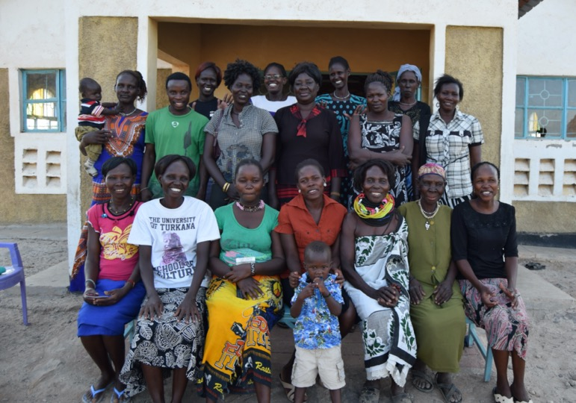
Notes:
The story of Kenny, the only male member that we know of who has been adopted into a women’s group, is a great story of a family working together to overcome poverty. You can see Kenny on the left wearing a green t-shirt. Kenny’s mother was the original member of Kitamanue Friends Women Group. She received a micro-loan in 2014 which she used to start a small store. At that time Kenny had already left home to start his own life. Their father had died. Unfortunately, the mother contracted malaria and died shortly after starting her business.

Slide 34
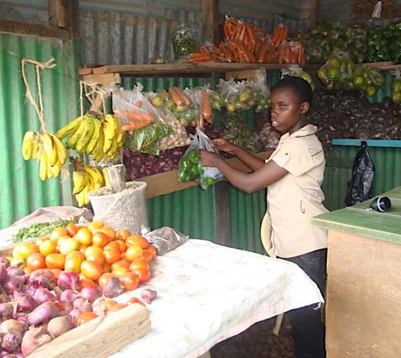
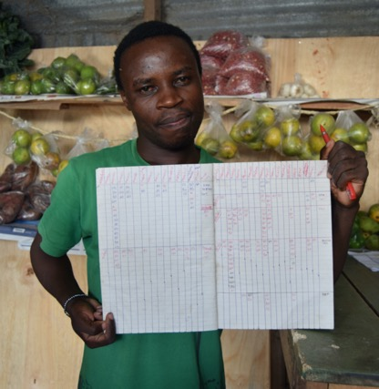
Notes:
(2 photos)
The oldest daughter, Catherine who was only 16, took over the running of the store and provided for her 4 younger brothers and sisters. This is Kenny’s sister Catherine running the store. However, she received a scholarship from Friends United Meeting to go to high school had to leave home because there were no high schools in her town. At that point, Catherine called Kenny and asked him to come home and take over the store.
Kenny didn’t know how to read and write very well but he agreed to let the women in his mother’s self-help group mentor him so he could learn to keep the financial records of the store. Here is Kenny proudly showing his financial bookkeeping records his first year.
It turned out that Kenny was a very good businessman and the store thrived and grew. He was able to send all of his younger siblings to high school and then to college. In January of 2018, the youngest brother had just started college in Nairobi. Kenny has expanded the store tremendously and opened a second store in another location.

Slide 35
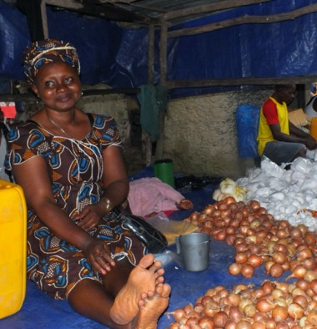
Lives are Transformed
Family income increased by 60% or more
Health and nutrition improved
More children are able to go to school
Women grow in self-confidence, skills, independence, and sustainability
Unified women create peace in community
Women participate in decision making, families and communities become stronger
Notes:
How does Right Sharing make a difference? [Read text]

Slide 36
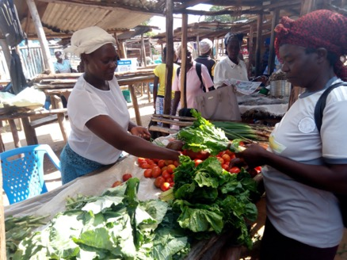
A Little Does a Lot
$5 One chicken for egg production
$6 Rake and hoe for farming
$15 Stove for a cooked food business
$50 A wheelbarrow for farming
$60 Bees for honey production
$115 A sewing machine
$150 Supplies to start a bun bakery
$200 Start a village food kiosk
$275 Start a rope making business
$333 One milk cow in India
$6,500 Funds 20 women to begin a micro enterprise business
Notes:
How much money does it take to make a difference? [Read text]

Slide 37
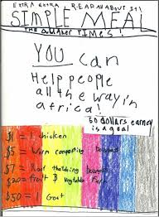
How can I make a difference?
Celebrate your blessings and share your abundance
Share newsletter
Use educational materials
Recycle stamps
Host a simple meal
Notes:
[Read aloud and insert these comments as needed]
RSWR newsletter is issued 4 times/year in print and electronically. Sign up on the website.
Educational materials are available on the website.
Used postage stamps can be sent to Stamps for Right Sharing, Indianapolis First Friends, 3030 Kessler Boulevard East Drive,Indianapolis IN 46220 (also on website) The stamps will be sorted and sold to stamp collectors to raise money for the RSWR program. Over $1500 is raised each year!
Hosting a Simple Meal provides an educational opportunity and donations help transform someone’s life.

Slide 38
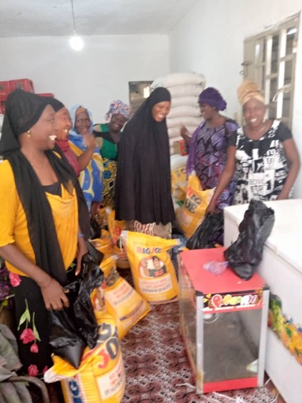
Share Your Abundance
Write a check or give online
Use Goodsearch.org
Use Smile.Amazon.org
Include RSWR in your estate plans
Notes:
Here are a variety of ways to share your financial abundance with Right Sharing of World Resources [read list and insert comments].
Goodsearch gives 1¢ each time you search; it is an alternative to google search.
If you use Amazon Smile, you can choose to benefit an organization like Right Sharing.
For estate planning, contact Jackie Stillwell, General Secretary to learn how your end of life gift can continue transforming lives.

Slide 39
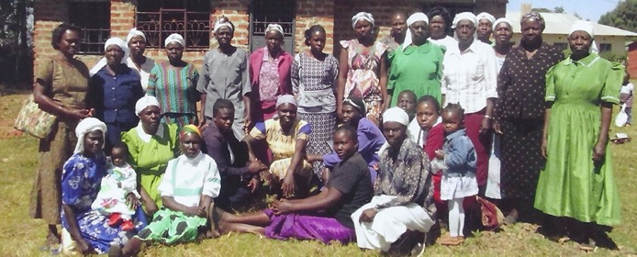
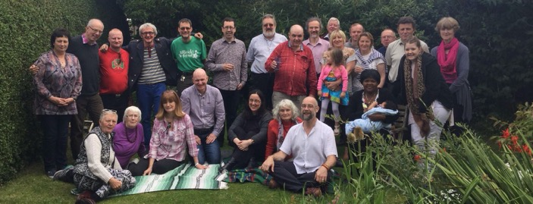
Sponsor a Project
Mugunga Friends Women Group sponsored by Eustace Street Friends Meeting in Dublin, Ireland
Notes:
RSWR offers the option for individuals, meetings, and groups to sponsor a specific RSWR project in Kenya, India, or Sierra Leone. This can be a wonderful opportunity for you and your meeting to build community by raising funds, choosing a project, learning more about the history and culture of the region, and sharing reports from the group. It also provides the occasion for education and sharing about how our choices affect others, and the reality of global wealth inequality. Learn more on our website or contact us directly.

Slide 40
All new and increased gifts will be matched dollar for dollar!
Notes:
Lastly, we invite you to participate in the Right Sharing challenge to Match funds. Several donors contributed a total of $250,000 as a challenge to invite new donors to make a gift and current donors to increase their giving. All new and increased gifts will continue to be matched dollar for dollar in 2020, and in 2021. (Thank you to everyone who participated in 2019, the first year of the challenge.) Your new and increased gifts make it possible to expand programming.

Slide 41
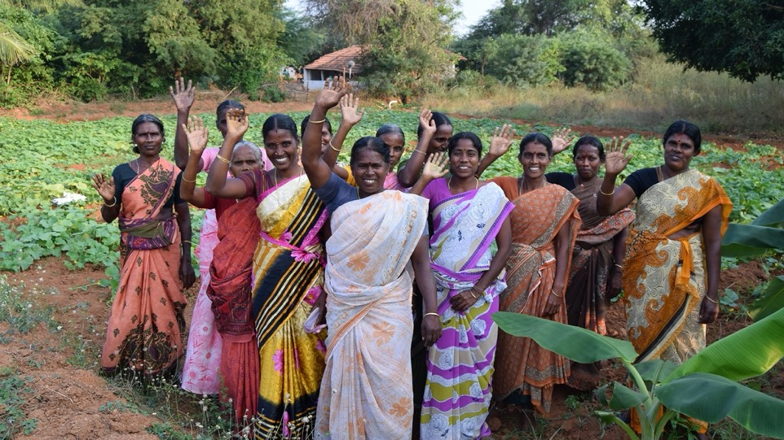
Thank you!

Slide 42
www.rswr.org
101 Quaker Hill Drive, Richmond, Indiana 47374
Notes:
Email: rswr@rswr.org or phone: ‭(937) 966-0314‬

